Slide 1




Project
Securing a Small Business Network -

Slide 2
Team Members
▪︎ Mohamed khaled
▪︎ Ahmaed Refat
▪︎ Hla Hatem
▪︎ Mostfa fouad

Slide 3
Introduction
The main objective of this project was to design and implement a secure, scalable, and efficient network for a small business environment with 30 employees.
Our design includes VLAN segmentation, firewall configurations, VPN implementation, and a DMZ (Demilitarized Zone)

Slide 4
project overview
Overview of the small business network with 30 employees
Description of services: Workstations, Printers, Server, Guest Wi-Fi
Main security focus: VLANs, Firewalls, VPN, and Access Control
Technologies used: Cisco Packet Tracer, Cisco 2911 Router, 2960 Switches

Slide 5
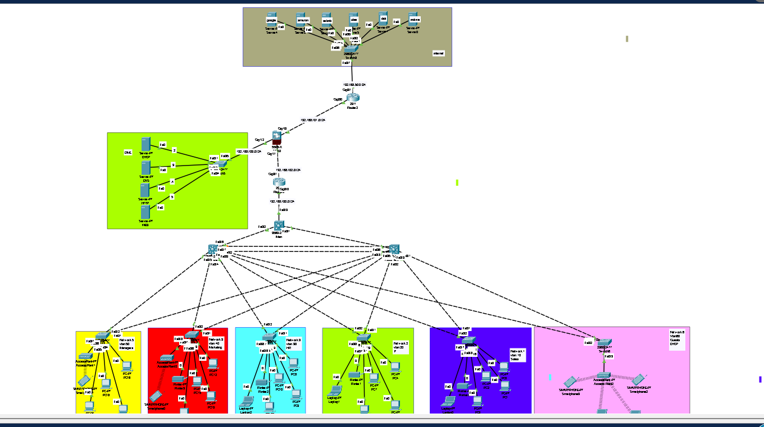

Network Topology Design
Components: Routers, Switches, Access Points, Firewalls, Servers
VLAN segmentation for department isolation

Slide 6
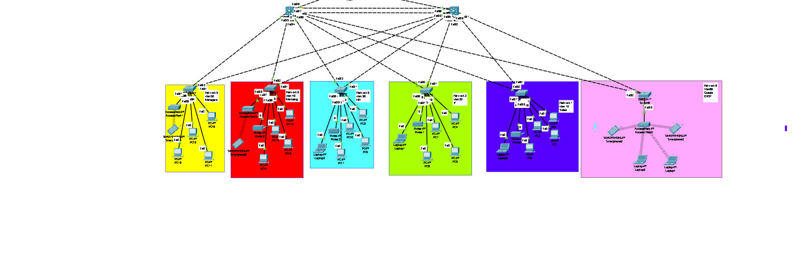
VLAN Segmentation - Overview
Logical separation of network into VLANs
Departments: Sales, IT, Marketing, HR, Managers, Guest
Enhanced manageability and security

Slide 7
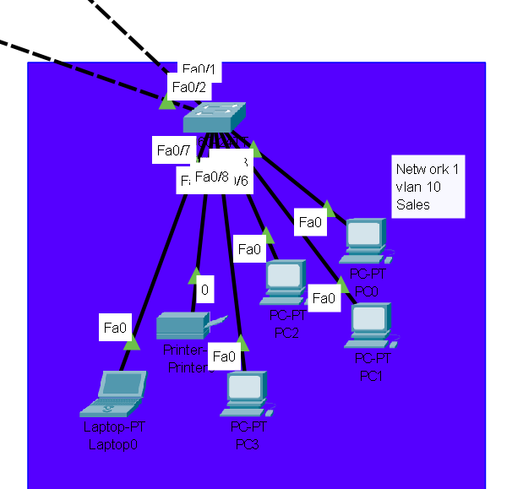
VLAN 10 (Sales)
VLAN 10 is specifically designed for the Sales department.
It is assigned the subnet 192.168.1.0/24. All the PCs and printers belonging to Sales are connected to this VLAN.
The main purpose of VLAN 10 is to keep Sales communications isolated and secure.
To ensure this, Access Control Lists (ACLs) are applied to filter traffic and prevent unauthorized access.
This not only improves security but also optimizes network performance by segmenting traffic

Slide 8
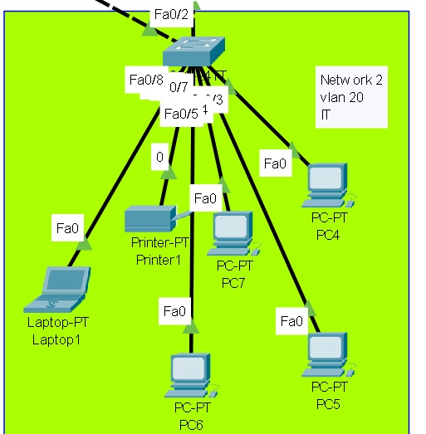
vlan 20 it
Moving on to VLAN 20,
this VLAN is dedicated to the IT department, with the subnet 192.168.2.0/24.
IT devices are given elevated permissions for configuration and management tasks.
We have implemented strong ACLs and strict firewall rules on VLAN 20.
This is because IT often handles sensitive network configurations and system administration tasks, which require additional protection against both internal and external threats

Slide 9
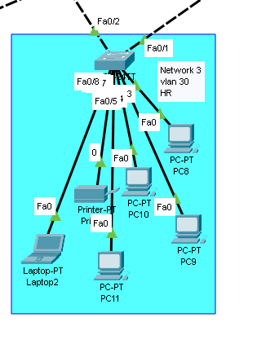
VLAN 30 (HR)
The HR department is isolated within VLAN 50, which uses the subnet 192.168.3.0/24.
This separation is crucial for maintaining the privacy of employee records and internal communications.
Strict ACLs are enforced to prevent unauthorized access to HR files, ensuring that sensitive information remains confidential and secure

Slide 10
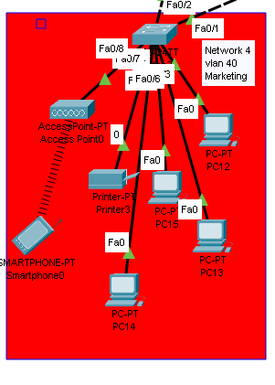
VLAN 40 (Marketing)
VLAN 40 supports the Marketing team and is assigned the subnet 192.168.4.0/24.
This VLAN includes the necessary PCs and printers for Marketing activities.
To ensure secure communication and data integrity, VLAN isolation and ACL restrictions are applied.
This prevents unnecessary traffic from reaching sensitive areas of the network while maintaining high availability for marketing operations

Slide 11
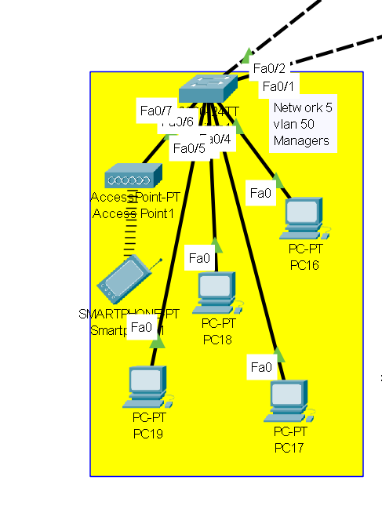
vlan 5 0 (managers)
VLAN 50 supports the Managers and is assigned the subnet 192.168.5.0/24.
This VLAN includes the necessary PCs and printers for managerial activities.
To ensure secure communication and data integrity, VLAN isolation and ACL restrictions are applied.
This prevents unnecessary traffic from reaching sensitive areas of the network while maintaining high availability for managerial operations.

Slide 12
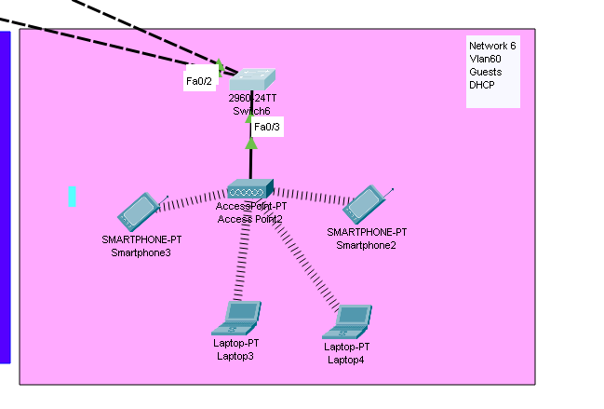
Guest Wireless Access – VLAN 60 Configuration
VLAN 60 is specifically created for Guest users.
It allows guests to connect through wireless access only. No wired connections are permitted for this VLAN.
The main purpose of VLAN 60 is to provide internet access to guests while keeping them isolated from the internal network.
To ensure this, Access Control Lists (ACLs) are applied to block access to internal VLANs and resources.
This setup not only enhances network security but also helps in managing bandwidth and reducing potential threats.

Slide 13
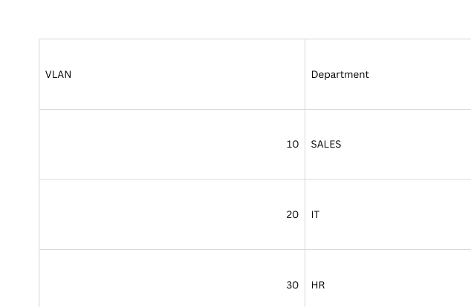
the subnet mask

Slide 14
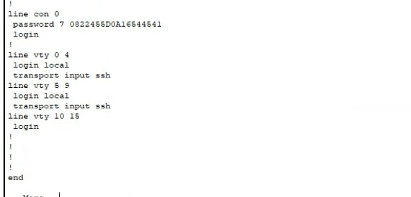
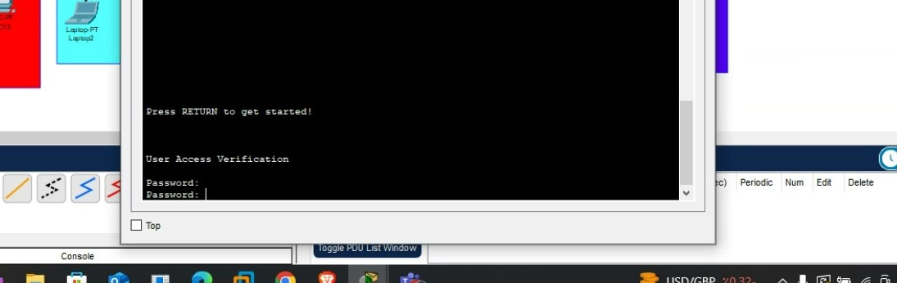
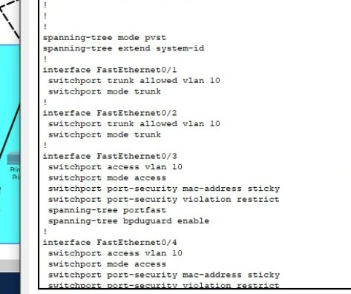
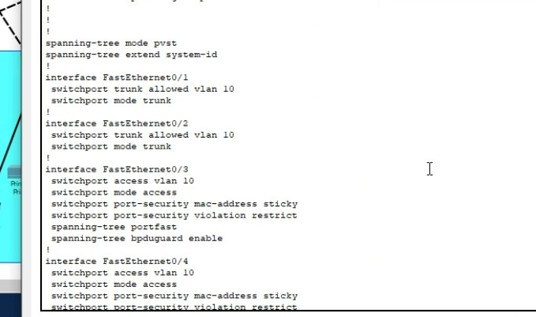
password consel
& vlan 10

Slide 15
Why VLANs Were Important
are essential for organizing and securing a network
Instead of having one big network where every device can communicatewith every other
Security: Devices in one VLAN can't access devices in another VLAN without permission
Performance: VLANs reduce unnecessary broadcast traffic, which improves overall network speed and reliability.

Slide 16
Network Devices & Roles
Router: “We used two routers one for internet access and one potentially for redundancy or connecting to a branch network.”
Multilayer Switches: “These handled inter-VLAN routing and connected all five access switches.”
Firewall: “We placed the firewall between the routers and internal network to inspect and filter traffic — especially between the DMZ and LAN.”

Slide 17
Security Policies Implemented

Slide 18
Security Policies
Firewall Rules:
Filtered traffic between internal, DMZ, and external networks.
Access Control Lists (ACLs):
Restrict access by IP, port, and protocol.
Intrusion Prevention Systems (IPS):
Detect and block suspicious or malicious activities.
WE MAKE SEGMENTATION TO OUR NETWORK USE VLAN FOr departments:
and isolate the dmz

Slide 19
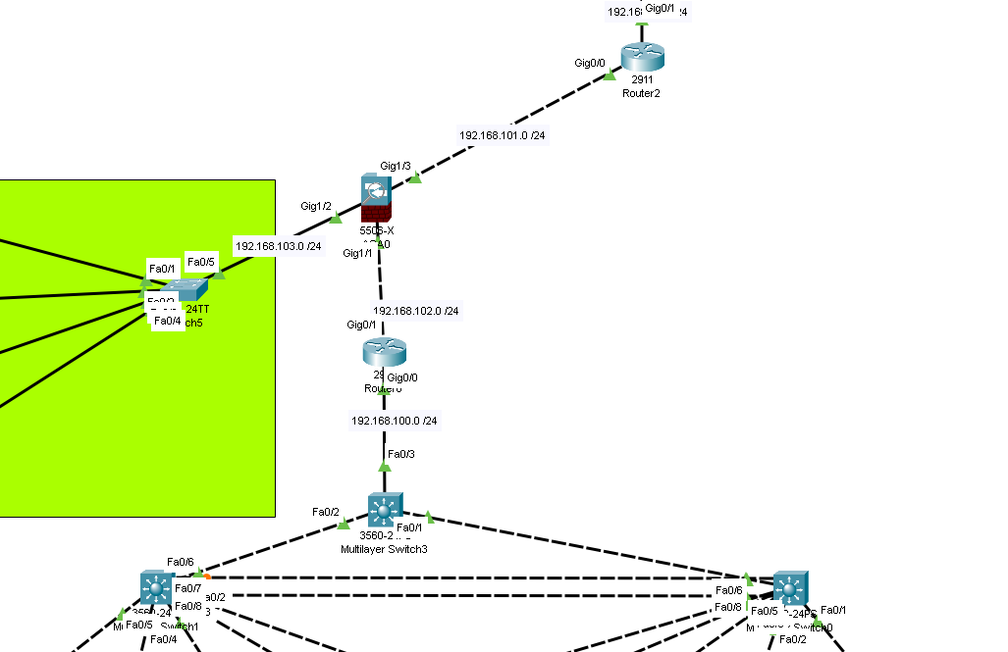
Firewall & Security Rules Overview
DMZ Isolation
➤ Block DMZ → Internal
➤ Allow HTTP/HTTPS from Internet → DMZ
Internal Network
➤ Allow HTTP/HTTPS/DNS to Internet
➤ Block inbound connections by default
Access Control Lists (ACLs)
➤ Allow only required ports
➤ Deny all other traffic
Web-Based VPN Access
➤ Allow secure HTTPS login
➤ Limit access to specific
resources Intrusion Prevention System (IPS)
➤ Monitor for attacks
➤ Block known threats
VLAN Security
➤ Isolate departments (HR, IT, Guests)
➤ No cross-VLAN access without permission
dmz
internet
internal network

Slide 20
firewall
To be honest, the firewall was one of the most challenging parts of our project. We didn’t cover it in detail during our training, so we had to rely heavily on online research to understand how to configure it.
While we managed to set up basic rules and connect it to the network, we’re aware that some parts of the configuration may not be fully correct or secure.
However, this gave us a chance to learn independently, and we now understand the importance of firewalls in real-world networks.”

Slide 21
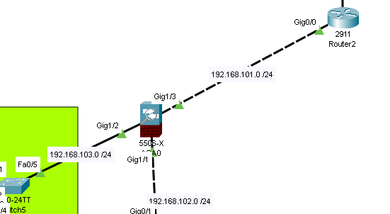
firewall
We used a firewall as our network's first line of defense. It is placed between the routers, the internal VLANs, and the DMZ.
\n\nThe firewall inspects all incoming and outgoing traffic. We created rules to allow only approved services — for example, web traffic to the web server in the DMZ — and block everything else by default.
\n\nThis setup helps us protect the internal network from both external threats and compromised public servers.
It also allows us to enforce access control policies, making sure that devices in one VLAN cannot reach another VLAN unless it's explicitly allowed.

Slide 22
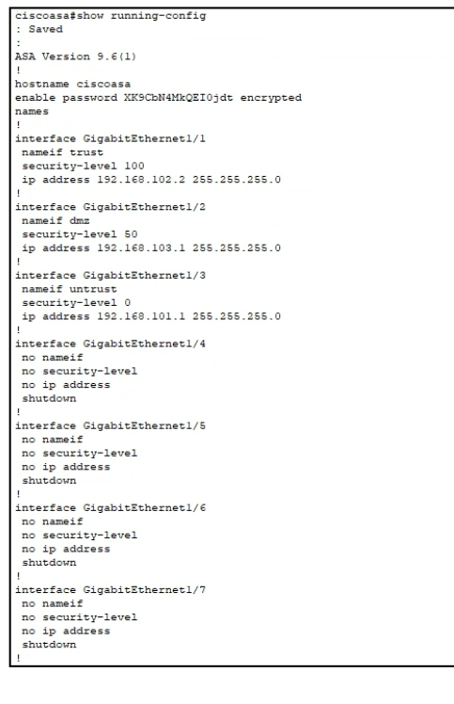

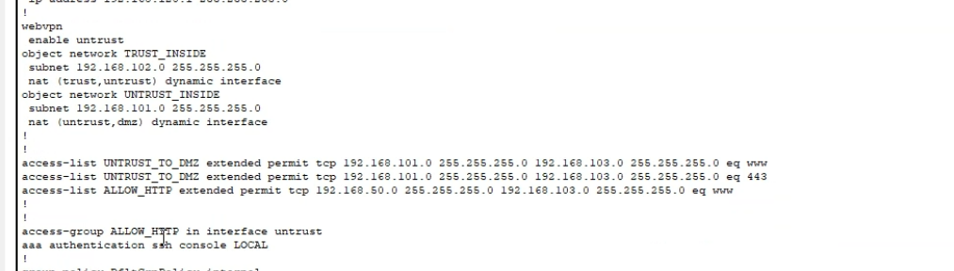
fire wall configration

Slide 23
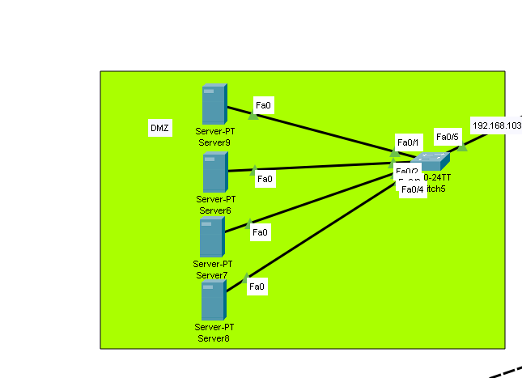
DMZ Network
The DMZ is where we placed our public servers like web and email.
This network is isolated from our internal VLANs,
so even if a public-facing server is attacked, the internal network stays protected.”
We configured a DMZ network using the subnet 192.168.103.0/24.
In this segment, we connected 4 public-facing servers — such as web, email, and FTP servers — to a dedicated switch.
This switch connects to the firewall, which controls all traffic in and out of the DMZ.
\n\nThe purpose of the DMZ is to host services that need to be accessible from the internet, while keeping our internal network protected.
Even if one of these servers is compromised, the attacker can’t reach our internal VLANs thanks to the firewall rules and network isolation.

Slide 24
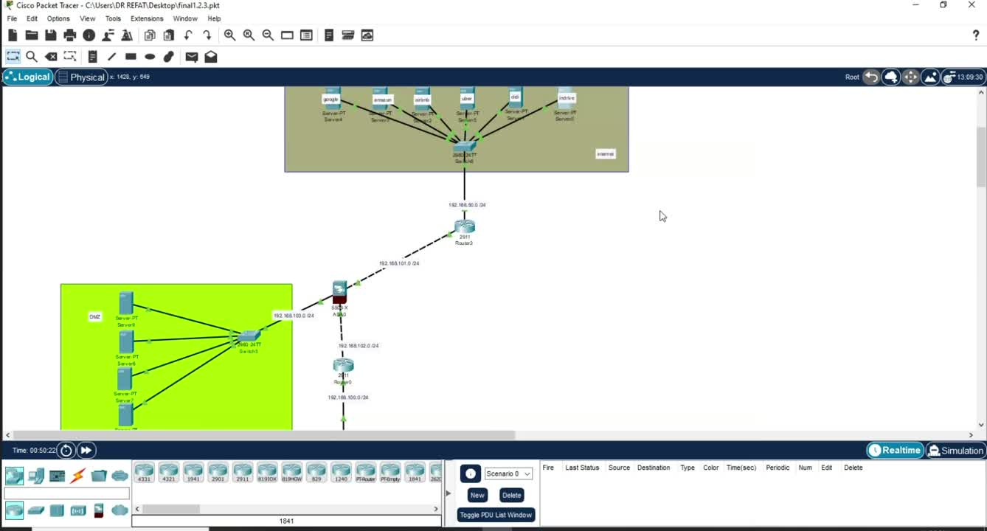

Slide 25
vpn implementation
Web VPN is a type of VPN (Virtual Private Network) that allows users to securely access internal network resources via a web browser, rather than needing specialized VPN client software. With a Web VPN,
Key Features of Web VPN:
why we make web vpn
Browser-Based Access
Security
Cross-Platform Support:
Cisco Packet Tracer doesn't support remote access VPNs in its current version

Slide 26
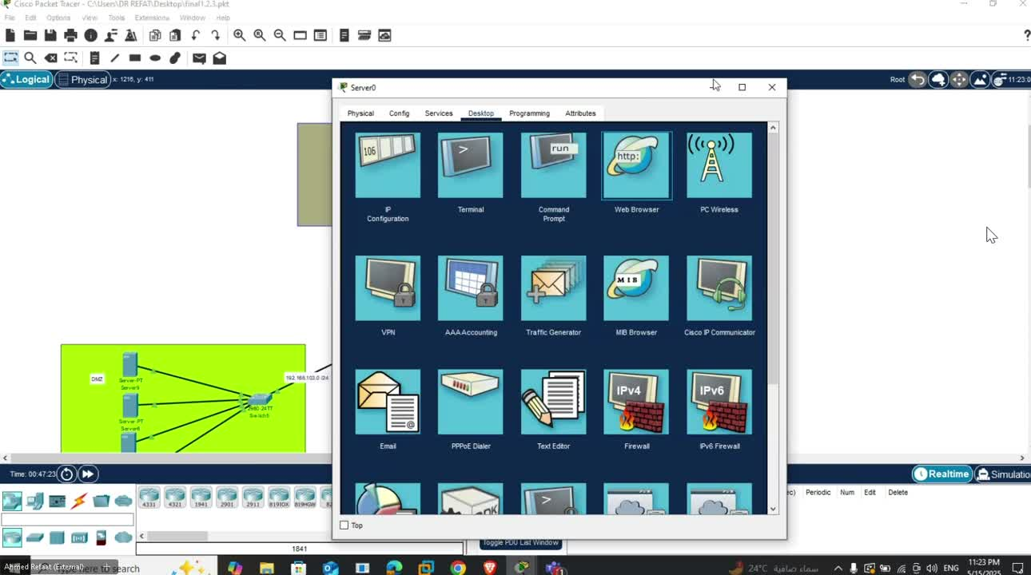

Slide 27
VPN configuration

Slide 28
Trust to Untrust
Trust to Untrust Policy refers to the configuration of security rules that allow or restrict traffic from a secure (Trusted) network zone to a less secure (Untrusted) network zone. In Cisco ASA 5506, this is achieved using:
Security Levels: Defining levels for interfaces (e.g., Inside = 100, Outside = 0).
Access Control Lists (ACLs): Controlling allowed and denied traffic.
Interface Configuration: Applying ACLs to interfaces.
Configuration Steps:
Define Security Levels: Assign a higher security level to Trusted (Inside) and lower to Untrusted (Outside).
Create ACLs: Specify traffic rules (e.g., allow HTTP, deny others).
Apply ACLs: Bind ACLs to interfaces.

Slide 29
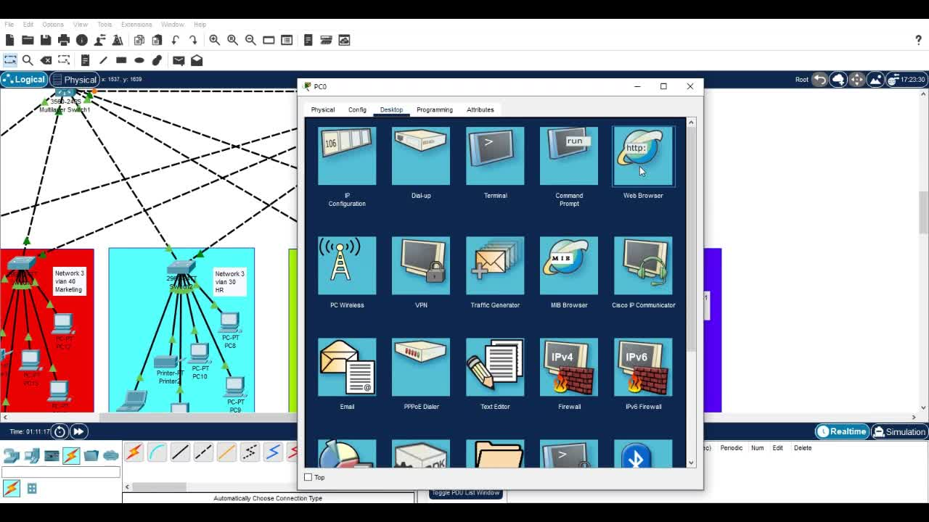

Slide 30
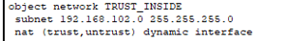

Slide 31
week2
Device Configuration
Configure routers, switches, and wireless access points as per the network design
Implement VLANs to segment the network logically by department or function
Set up routing protocols (e.g., OSPF, EIGRP) for efficient traffic flow between VLANs and networks
Ensure device security settings like strong passwords and management access controls

Slide 32
Security Hardening
Change default passwords on all devices
Disable unused services to reduce attack surface
Keep devices up-to-date with latest patches

Slide 33
Vulnerability Assessment
Run full vulnerability scans regularly
Identify and fix security gaps promptly
Security Monitoring
Enable logging on all devices
Use monitoring tools to detect unusual activity
Analyze logs to prevent and respond to threats early

Slide 34
SSH Configuration
Set Device Hostname & Domain
sales
it
markting
hr
managers
To enhance network security, Telnet access was disabled, and SSH was configured as the secure remote access method.

Slide 35
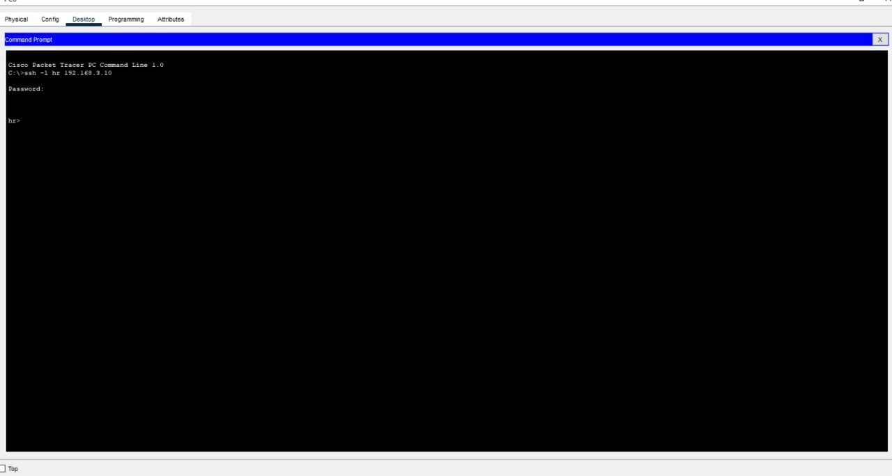
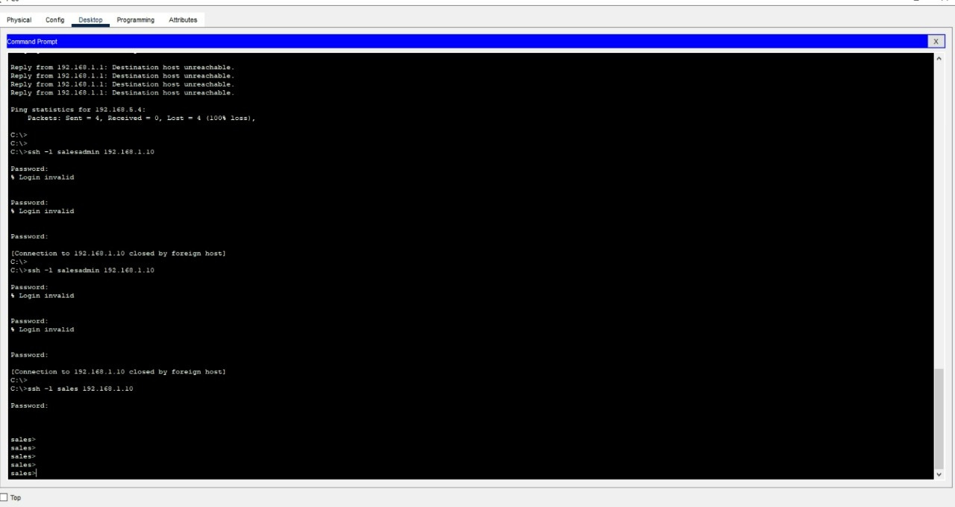
test shh

Slide 36
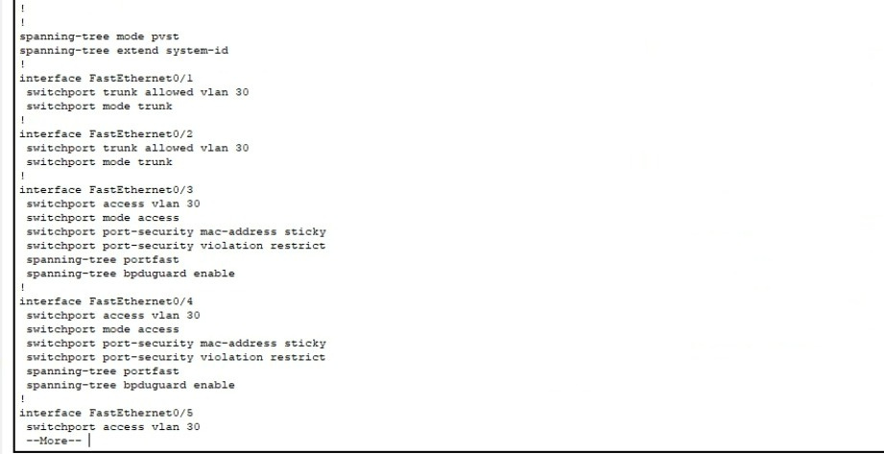
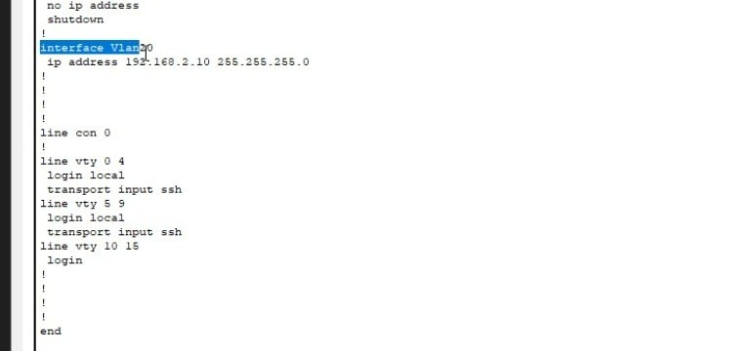
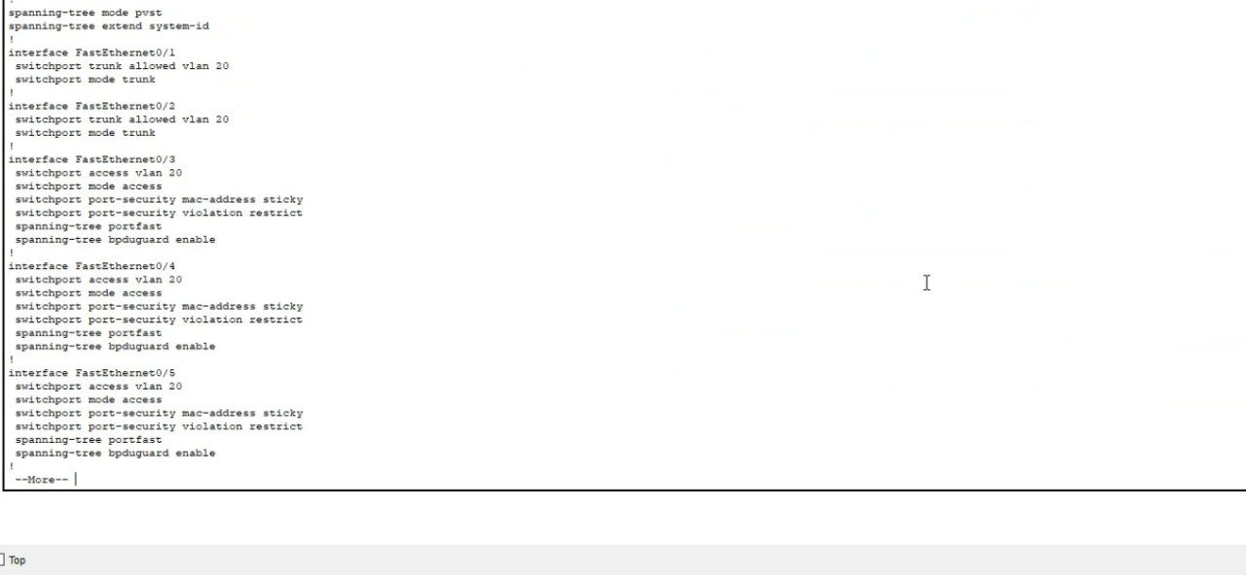
vlan 20&30

Slide 37
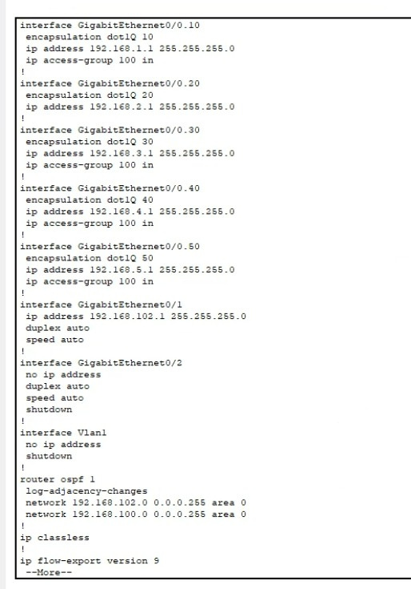
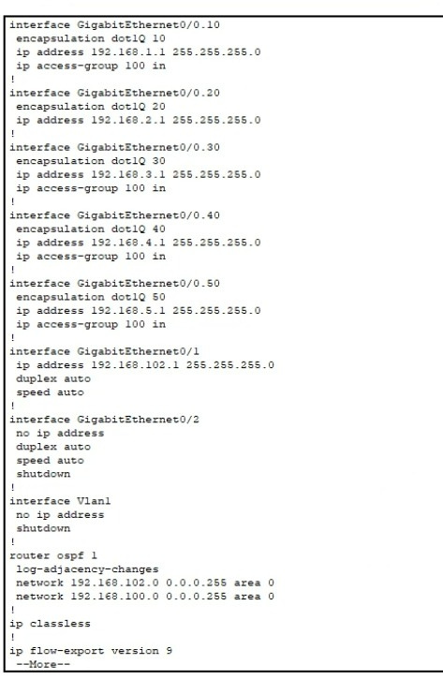
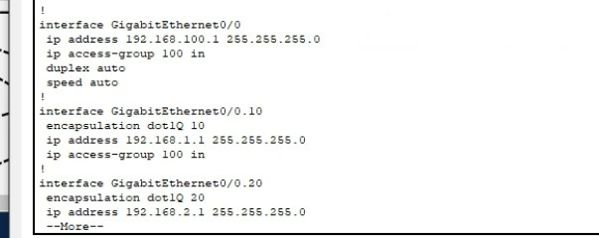
router confegration

Slide 38
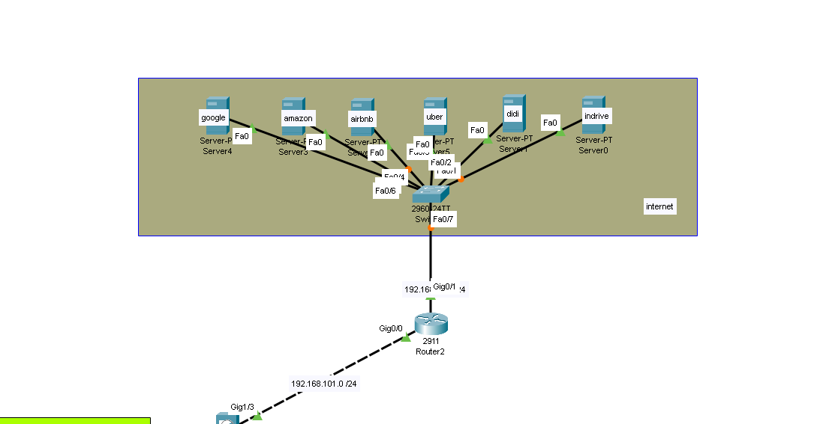
router and internat
In our network design, we use Router2 (Cisco 2911) as the central gateway to connect our internal network to the internet and also as a secure connection point to the firewall.
Internal Network Design:
Our internal network includes multiple servers simulating services like Google, Amazon, Airbnb, Uber, Didi, Indrive, etc.
These servers are connected through a 2960-24TT Switch, which handles internal traffic switching.

Slide 39
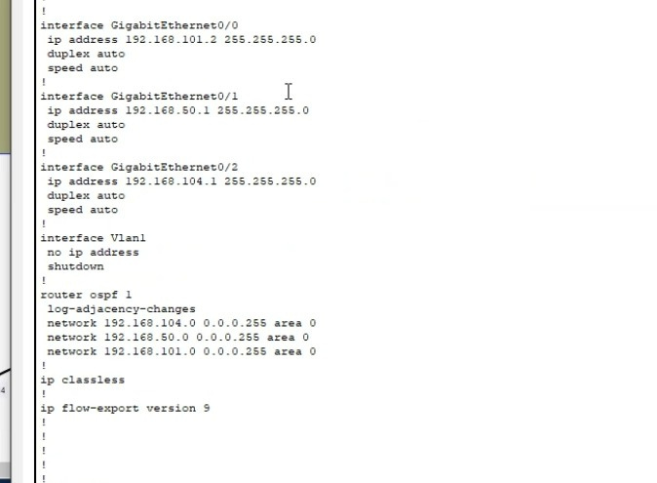
router 2 confegration

Slide 40
Conclusion
In this project, we successfully applied core networking and cybersecurity concepts to design and secure a small business network.
We implemented VLANs, subnetting, ACLs, and wireless segmentation to ensure both functionality and protection for different user groups.
This hands-on experience bridged the gap between theory and practice, preparing us for real-world network security challenges.
thank you Eng : Mohamed Abdelkader

Slide 41

our project
scan to open

Slide 42
Thank You

